Slide 1


Direction Sense
East
By
Rahul Patil
9096056299

Slide 2


North
South
East West

Slide 3


North
West
East
South

Slide 4
North-East
North-West
South-East South-West

Slide 5
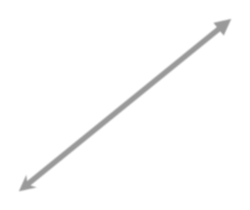

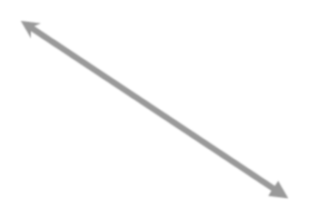
N
N - E
N - W
W
E
S - W
S
S - E

Slide 6
At The Time of Sunrise
If a man stands facing the east, then his shadow will be towards the west.
If a man stands facing the North, his shadow will be towards his left.

Slide 7
At The Time of Sunset
The shadow of an object is always in the east.
If a man stands facing the North, his shadow will be towards his right.

Slide 8
At 12:00 Noon
The rays of the sun are vertically downward hence there will be no shadow.

Slide 9
Find the Direction & Distance from Starting Position, When –
A Person, goes 6 km in the East, then he turns to his left and goes 4 km, Finally he turns to his left and goes 6 km.

Slide 10

Step 1 - A Person, goes 6 km in the East
6 Km
Step 2 - then he turns to his left & goes 4 km
4 Km
6 Km

Slide 11
Step 3 - Finally he turns to his left & goes 6 km
6 km
4 Km
6 Km
So, 4 km is the answer & he is facing the North Direction.

Slide 12
A man starting from his house, goes 3 km in west. then turns to his left & walks 4 km.
What will be the minimum distance will be covered by him to come back to his house & Direction from the Starting Position?

Slide 13
Step 1 - Goes 3 km in west
3 Km
3 Km
Step 2 - he turns to his left & walks 4 km
4 Km

Slide 14
Step 3 - Minimum Distance to come back to his house
= (𝟑)² + (4)²
3 Km
= 𝟗 + 𝟏𝟔
4 Km
= 𝟐𝟓
= 5
So, The Minimum Distance is = 5 km

Slide 15
After Sunrise, A met with B at a crossing point. B’s Shadow was exactly to right of A.
If they were facing each other on which direction was A facing?

Slide 16
Sun Always Rises in the East Direction. So Shadow falls towards West.
B's shadow falls to the right of the A. Hence A is facing South.
So, A is facing South

Slide 17
Thank You!

